Slide 1
Intelligent Agents
CHAPTER 2
Oliver Schulte
Summer2011

Slide 2
Outline
Agents and environments
Rationality
PEAS (Performance measure, Environment, Actuators, Sensors)
Environment types
Agent types
Artificial Intelligence a modern approach

Slide 3
Agents
An agent is anything that can be viewed as perceiving its environment through sensors and acting upon that environment through actuators
Human agent:
  eyes, ears, and other organs for sensors;
  hands, legs, mouth, and other body parts for actuators
Robotic agent:
  cameras and infrared range finders for sensors
  various motors for actuators
Artificial Intelligence a modern approach

Slide 4

Agents and environments
The agent function maps from percept histories to actions:
[f: P* → A]
The agent program runs on the physical architecture to produce f
agent = architecture + program
Artificial Intelligence a modern approach

Slide 5

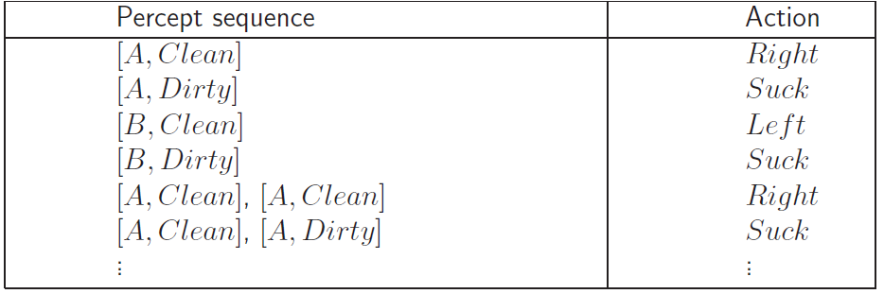
Vacuum-cleaner world
Demo: http://www.ai.sri.com/~oreilly/aima3ejava/aima3ejavademos.html
Percepts: location and contents, e.g., [A,Dirty]
Actions: Left, Right, Suck, NoOp
Agent’s function → look-up table
  For many agents this is a very large table
Artificial Intelligence a modern approach
Notes:
Only 2 locations

Slide 6
Rational agents
Rationality
  Performance measuring success
  Agents prior knowledge of environment
  Actions that agent can perform
  Agent’s percept sequence to date
Rational Agent: For each possible percept sequence, a rational agent should select an action that is expected to maximize its performance measure, given the evidence provided by the percept sequence and whatever built-in knowledge the agent has.
Artificial Intelligence a modern approach

Slide 7
Examples of Rational Choice
See File: intro-choice.doc
Artificial Intelligence a modern approach

Slide 8
Rationality
Rational is different from omniscience
  Percepts may not supply all relevant information
  E.g., in card game, don’t know cards of others.
Rational is different from being perfect
  Rationality maximizes expected outcome while perfection maximizes actual outcome.
Artificial Intelligence a modern approach

Slide 9
Autonomy in Agents
The autonomy of an agent is the extent to which its
behaviour is determined by its own experience,
rather than knowledge of designer.
Extremes
  No autonomy – ignores environment/data
  Complete autonomy – must act randomly/no program
Example: baby learning to crawl
Ideal: design agents to have some autonomy
  Possibly become more autonomous with experience

Slide 10
PEAS
PEAS: Performance measure, Environment, Actuators, Sensors
Must first specify the setting for intelligent agent design
Consider, e.g., the task of designing an automated taxi driver:
  Performance measure: Safe, fast, legal, comfortable trip, maximize profits
  Environment: Roads, other traffic, pedestrians, customers
  Actuators: Steering wheel, accelerator, brake, signal, horn
  Sensors: Cameras, sonar, speedometer, GPS, odometer, engine sensors, keyboard
Artificial Intelligence a modern approach

Slide 11
PEAS
Agent: Part-picking robot
Performance measure: Percentage of parts in correct bins
Environment: Conveyor belt with parts, bins
Actuators: Jointed arm and hand
Sensors: Camera, joint angle sensors
Artificial Intelligence a modern approach

Slide 12
PEAS
Agent: Interactive English tutor
Performance measure: Maximize student's score on test
Environment: Set of students
Actuators: Screen display (exercises, suggestions, corrections)
Sensors: Keyboard
Artificial Intelligence a modern approach

Slide 13
Environment types
Fully observable (vs. partially observable)
Deterministic (vs. stochastic)
Episodic (vs. sequential)
Static (vs. dynamic)
Discrete (vs. continuous)
Single agent (vs. multiagent):
Artificial Intelligence a modern approach

Slide 14
Fully observable (vs. partially observable)
Is everything an agent requires to choose its actions available to it via its sensors? Perfect or Full information.
  If so, the environment is fully accessible
If not, parts of the environment are inaccessible
  Agent must make informed guesses about world.
In decision theory: perfect information vs. imperfect information.
Cross Word
Poker
Backgammon
Taxi driver
Part picking robot
Image analysis
Fully
Partially
Partially
Partially
Fully
Fully
Artificial Intelligence a modern approach
Notes:
Satellite image analysis. Some categories depend on definition of task.

Slide 15
Deterministic (vs. stochastic)
Does the change in world state
  Depend only on current state and agent’s action?
Non-deterministic environments
  Have aspects beyond the control of the agent
  Utility functions have to guess at changes in world
Cross Word
Cross Word
Poker
Poker
Backgammon
Backgammon
Taxi driver
Taxi driver
Part
Part picking robot
Image analysis
Image analysis
Deterministic
Stochastic
Stochastic
Stochastic
Stochastic
Deterministic
Artificial Intelligence a modern approach

Slide 16
Episodic (vs. sequential):
Is the choice of current action
  Dependent on previous actions?
  If not, then the environment is episodic
In non-episodic environments:
  Agent has to plan ahead:
    Current choice will affect future actions
Cross Word
Poker
Backgammon
Taxi driver
Part picking robot
Image analysis
Sequential
Sequential
Sequential
Sequential
Episodic
Episodic
Artificial Intelligence a modern approach

Slide 17
Static (vs. dynamic):
Static environments don’t change
  While the agent is deliberating over what to do
Dynamic environments do change
  So agent should/could consult the world when choosing actions
  Alternatively: anticipate the change during deliberation OR make decision very fast
Semidynamic: If the environment itself does not change with the passage of time but the agent's performance score does.
Cross Word
Poker
Backgammon
Taxi driver
Part picking robot
Image analysis
Static
Static
Static
Dynamic
Dynamic
Semi
Another example: off-line route planning vs. on-board navigation system
Artificial Intelligence a modern approach

Slide 18
Discrete (vs. continuous)
A limited number of distinct, clearly defined percepts and actions vs. a range of values (continuous)
Cross Word
Poker
Backgammon
Taxi driver
Part picking robot
Image analysis
Discrete
Discrete
Discrete
Conti
Conti
Conti
Artificial Intelligence a modern approach

Slide 19
Single agent (vs. multiagent):
An agent operating by itself in an environment or there are many agents working together
Cross Word
Poker
Backgammon
Taxi driver
Part picking robot
Image analysis
Single
Multi
Multi
Multi
Single
Single
Artificial Intelligence a modern approach

Slide 20
Summary.
Observable
Deterministic
Episodic
Static
Discrete
Agents
Cross Word
Fully
Deterministic
Sequential
Static
Discrete
Single
Poker
Fully
Stochastic
Sequential
Static
Discrete
Multi
Backgammon
Partially
Stochastic
Sequential
Static
Discrete
Multi
Taxi driver
Partially
Multi
Stochastic
Sequential
Dynamic
Conti
Part picking robot
Partially
Stochastic
Episodic
Dynamic
Conti
Single
Image analysis
Fully
Deterministic
Episodic
Semi
Conti
Single
Artificial Intelligence a modern approach
Notes:
How many environment types are there in total?

Slide 21
Choice under (Un)certainty
Fully Observable
yes
no
Deterministic
no
yes
Certainty: Search
Uncertainty
Artificial Intelligence a modern approach
Notes:
Comparison to game theory. How can you have full observability with nondeterminism? E.g. GPS system: knows its state, but doesn’t know whether driver will follow its instructions. Can argue philosophically that nondeterminism involves partial observability because there must be hidden factors that determine outcome.

Slide 22
Agent types
Four basic types in order of increasing generality:
  Simple reflex agents
  Reflex agents with state/model
  Goal-based agents
  Utility-based agents
  All these can be turned into learning agents
  http://www.ai.sri.com/~oreilly/aima3ejava/aima3ejavademos.html
Artificial Intelligence a modern approach

Slide 23

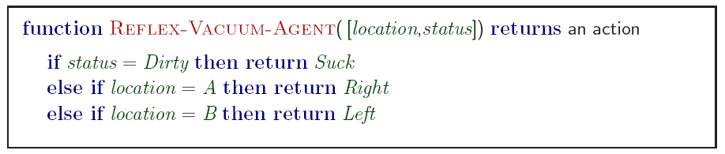
Simple reflex agents
Artificial Intelligence a modern approach
Notes:
Based on sensors

Slide 24
Simple reflex agents
Simple but very limited intelligence.
Action does not depend on percept history, only on current percept.
Therefore no memory requirements.
Infinite loops
  Suppose vacuum cleaner does not observe location. What do you do given location = clean? Left of A or right on B -> infinite loop.
  Fly buzzing around window or light.
  Possible Solution: Randomize action.
  Thermostat.
Chess – openings, endings
  Lookup table (not a good idea in general)
    35¹⁰⁰ entries required for the entire game
Artificial Intelligence a modern approach
Notes:
Another example: fly buzzing against window.

Slide 25
States: Beyond Reflexes
Recall the agent function that maps from percept histories to actions:
[f: P* → A]
An agent program can implement an agent function by maintaining an internal state.
The internal state can contain information about the state of the external environment.
The state depends on the history of percepts and on the history of actions taken:
[f: P*, A*→ S →A] where S is the set of states.
If each internal state includes all information relevant to information making, the state space is Markovian.
Artificial Intelligence a modern approach

Slide 26
States and Memory: Game Theory
If each state includes the information about the percepts and actions that led to it, the state space has perfect recall.
Perfect Information = Perfect Recall + Full Observability + Deterministic Actions.
Artificial Intelligence a modern approach

Slide 27

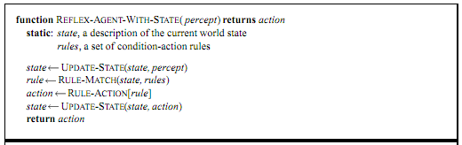
Model-based reflex agents
Know how world evolves
  Overtaking car gets closer from behind
How agents actions affect the world
  Wheel turned clockwise takes you right
Model base agents update their state
Artificial Intelligence a modern approach

Slide 28
Goal-based agents
knowing state and environment? Enough?
  Taxi can go left, right, straight
Have a goal
  A destination to get to
Uses knowledge about a goal to guide its actions
  E.g., Search, planning
Artificial Intelligence a modern approach

Slide 29

Goal-based agents
Reflex agent breaks when it sees brake lights. Goal based agent reasons
  Brake light -> car in front is stopping -> I should stop -> I should use brake
Artificial Intelligence a modern approach

Slide 30
Utility-based agents
Goals are not always enough
  Many action sequences get taxi to destination
  Consider other things. How fast, how safe…..
A utility function maps a state onto a real number which describes the associated degree of “happiness”, “goodness”, “success”.
Where does the utility measure come from?
  Economics: money.
  Biology: number of offspring.
  Your life?
Artificial Intelligence a modern approach
Notes:
Example: why is it important to get a good grade in this course?

Slide 31

Utility-based agents
Artificial Intelligence a modern approach

Slide 32

Learning agents
Performance element is what was previously the whole agent
  Input sensor
  Output action
Learning element
  Modifies performance element.
Artificial Intelligence a modern approach
Notes:
Problem generator: acts in new ways, explores.

Slide 33
Learning agents
Critic: how the agent is doing
  Input: checkmate?
  Fixed
Problem generator
  Tries to solve the problem differently instead of optimizing.
  Suggests exploring new actions -> new problems.
Artificial Intelligence a modern approach

Slide 34
Learning agents(Taxi driver)
  Performance element
    How it currently drives
  Taxi driver Makes quick left turn across 3 lanes
    Critics observe shocking language by passenger and other drivers and informs bad action
    Learning element tries to modify performance elements for future
    Problem generator suggests experiment out something called Brakes on different Road conditions
  Exploration vs. Exploitation
    Learning experience can be costly in the short run
    shocking language from other drivers
    Less tip
    Fewer passengers
Artificial Intelligence a modern approach

Slide 35
The Big Picture: AI for Model-Based Agents
Planning
Decision Theory
Game Theory
Action
Reinforcement Learning
Knowledge
Learning
Logic
Probability
Heuristics
Inference
Machine Learning
Statistics
Artificial Intelligence a modern approach

Slide 36
The Picture for Reflex-Based Agents
Action
Reinforcement Learning
Learning
Studied in AI, Cybernetics, Control Theory, Biology, Psychology.
Artificial Intelligence a modern approach

Slide 37
Discussion Question
Model-based behaviour has a large overhead.
Our large brains are very expensive from an evolutionary point of view.
Why would it be worthwhile to base behaviour on a model rather than “hard-code” it?
For what types of organisms in what type of environments?
Artificial Intelligence a modern approach

Slide 38
Summary
Agents can be described by their PEAS.
Environments can be described by several key properties: 64 Environment Types.
A rational agent maximizes the performance measure for their PEAS.
The performance measure depends on the agent function.
The agent program implements the agent function.
3 main architectures for agent programs.
In this course we will look at some of the common and useful combinations of environment/agent architecture.
Artificial Intelligence a modern approach

